Slide 1
WSN@home and IoT Peter Van Aken

Slide 2
What can you expect from this session ?
How to build a low energy, low cost WSN yourself,
How WSN can be applied in YOUR home,
Demo of live WSN@home
…path forward …
Let’s start with a couple of facts …

Slide 3

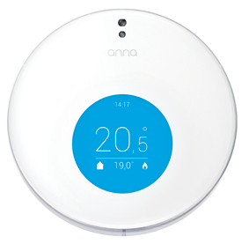
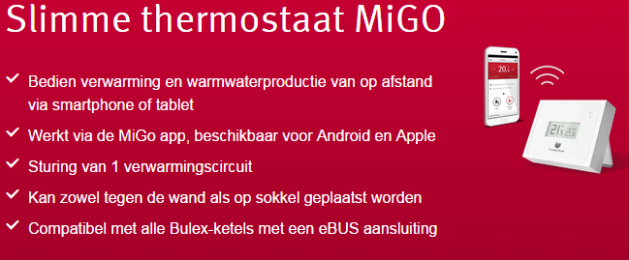
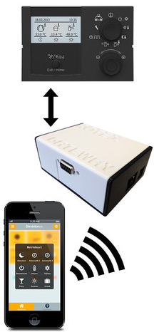
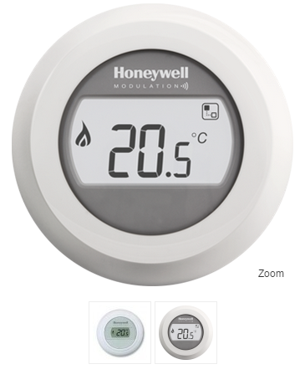

Facts … temperature
Meet Anna…smart, beautiful and cool …

Slide 4

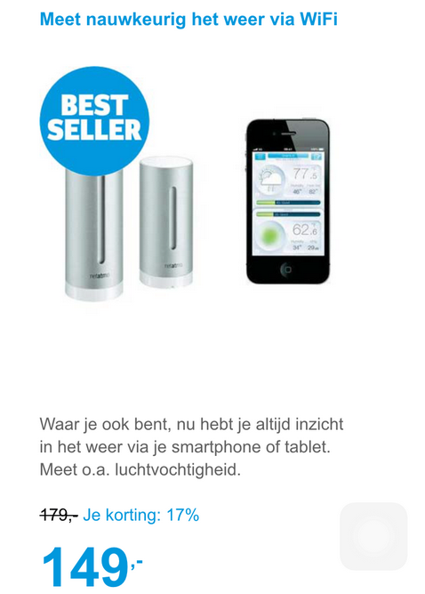
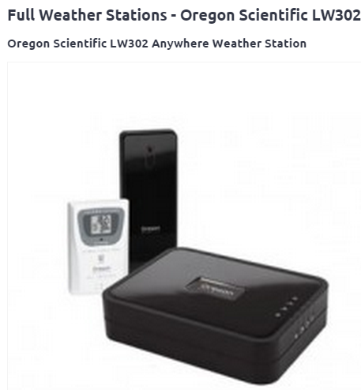
Facts … weather

Slide 5
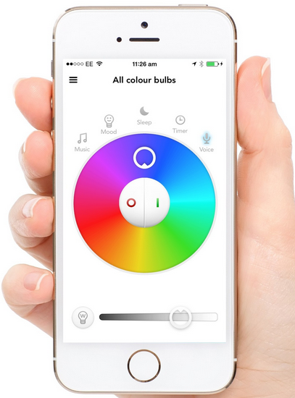
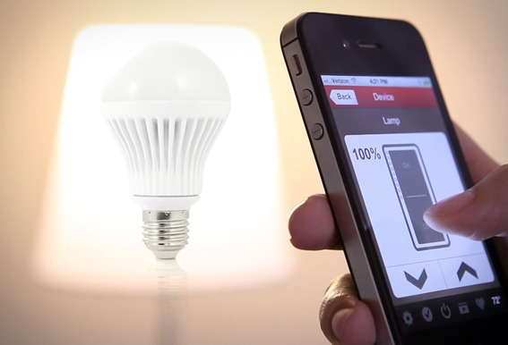
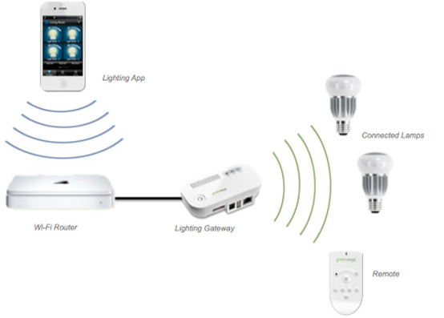
Facts … light

Slide 6


Facts …smart cars, watch…etc

Slide 7
What does IoT means for me?
It is reality … being built today
All different type of things connected to the internet …
But basically it is about:
data,
networking,
measuring (via sensors) and controlling (through actuators)
…it is/will changing/change the way we’re living

Slide 8
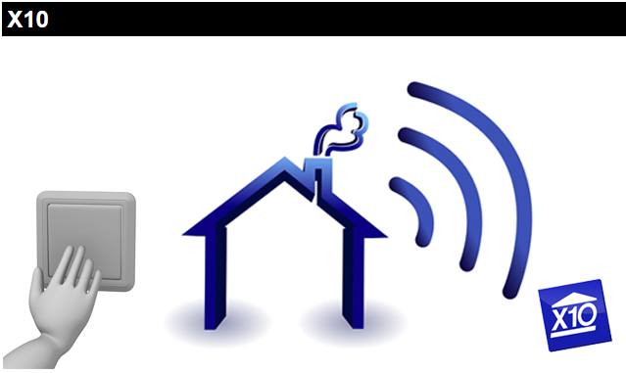

Home automation protocols
X10 :
1975 / domotica
Power line & RF (433Mhz)
60 bps
Used EU : +
UPB : (Universal powerline bus)
1999 / Powerline only
120 bps
Used EU : --

Slide 9

Home automation protocols
Insteon
2005
Power line & RF (916Mhz)
Meshing topology
180 bps
Used EU : - / ++ (USA)

Slide 10

Home automation protocols
Z-wave
2008
RF (868/916Mhz)
Meshing topology
100 kbps
Used EU : +
E.g http://www.fibaro.com/en

Slide 11
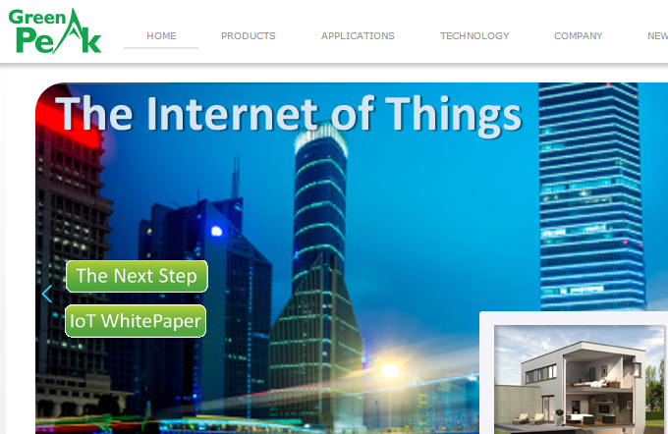

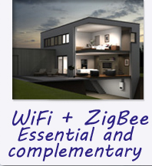
Home automation protocols
Zigbee
BLE
Velbus
KNX
CAN
Wifi
EnOcean
…and growing

Slide 12
Home automation protocols
Conclusion :
huge amount of protocols,
wired & wireless,
Licensed and license-free,
high power / low power / no power
…so, why not adding an own protocol to the list and start from my requirements looking at home …

Slide 13
My requirements
Wireless :
easy to install in existing house
Mixed power
Powerplug and battery
Low cost
Secure
Sensors / actuators
Tranceiver
Meshing network
low power
Accessible from anywhere and any device

Slide 14
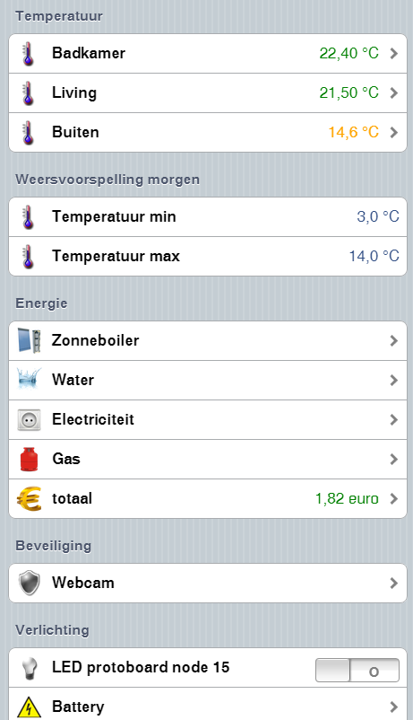
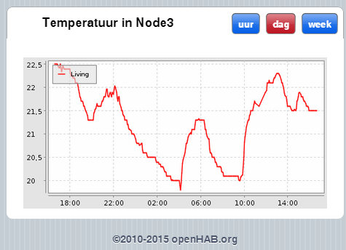
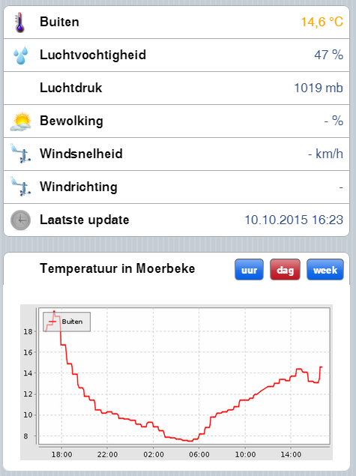
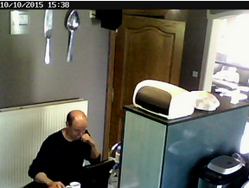
WSN@home in action
DEMO

Slide 15
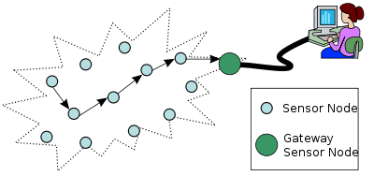
Different component in WSN ?
Sensor/actuator Node : measure/control
Gateway : connect nodes <-> controller
Controller : connect network to UE/Internet

Slide 16
WSN@home breakdown
Nodes :
Common platform :
uC : Atmel atmega328P (8bit AVR / 32KB flash / 1.8v-5.5v operation)
RF : nordic NRF24L01+ (ultra LP (nA) / 2Mbps / ISM band / transceiver / 1.9v-3.6v operation)
Both can be powered from 3v supply = 2xAA/2xAAA/CR2032…
Specific standard interface : i2C (TWI), SPI, onewire, serial
Lots of prototyping platforms available for uC : Arduino UNO, nano, pro mini, …

Slide 17

WSN@home breakdown
Nodes :
Different RF modules : onboard/external antenna, PA (power amplifier), LNA (Low Noise amplifier), SMD/die/TSOP : open air range : 30 – 1100 m
Firmware :
baremetal, specific bootloader for OTA
“mySensors” stack (http://www.mysensors.org)
Interface specific
+-30% mem utilisation

Slide 18
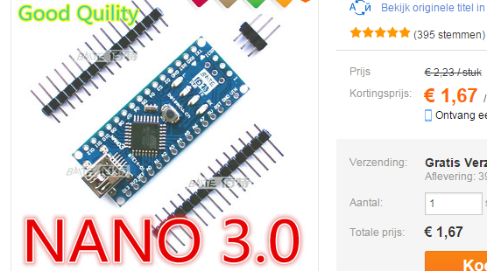
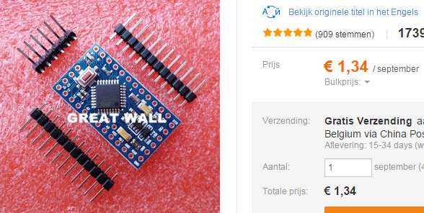
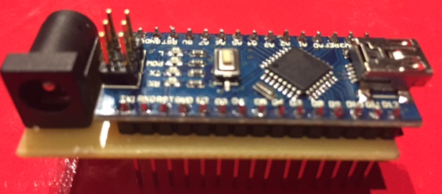
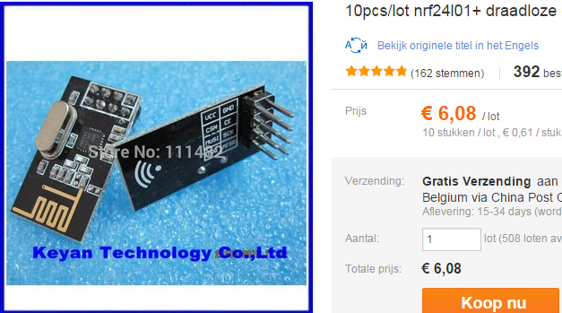
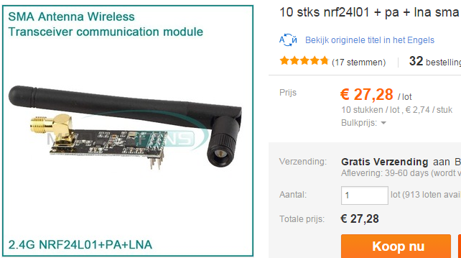
WSN@home breakdown
Nodes :
Cost

Slide 19
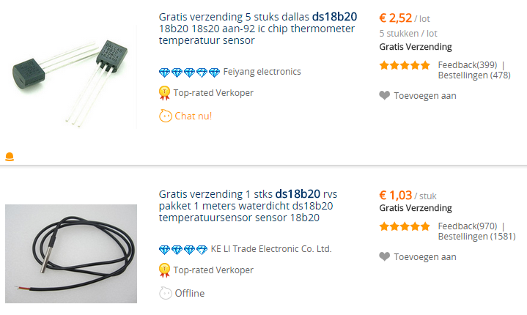
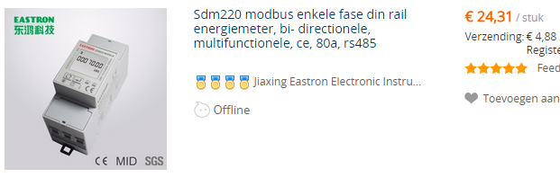
Node examples
Temperature node :
Specific interface :
onewire
Sensor : DS18B20
cost
Electricity node :
Specific interface : RS485/Modbus
Sensor :
cost

Slide 20
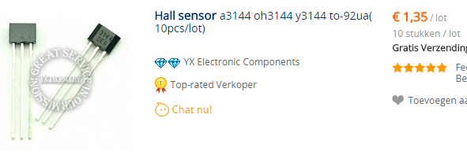
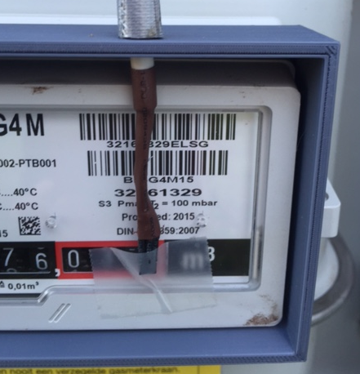
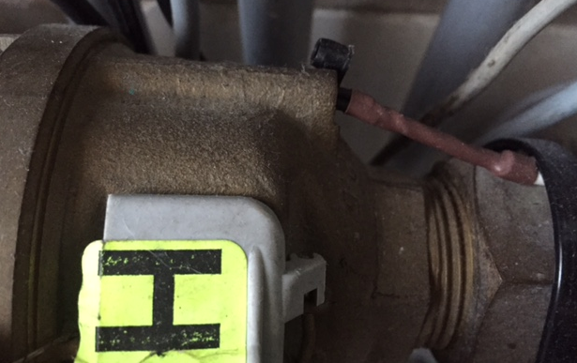
Node examples
Water/gas node
Specific interface : digital input
Sensor : Hall effect switch a3121eua
Cost

Slide 21
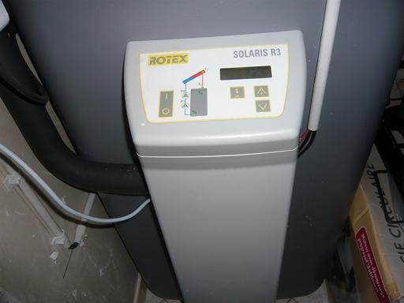
Node examples
Solar boiler node
Specific interface : RS232
Sensor : ROTEX Solaris RPS3
Cost /

Slide 22
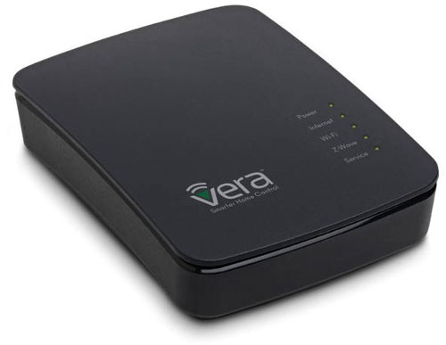
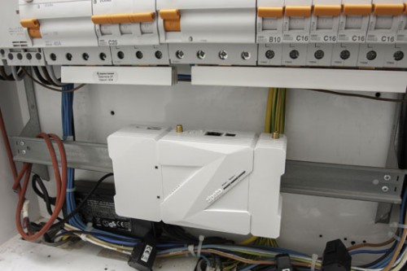

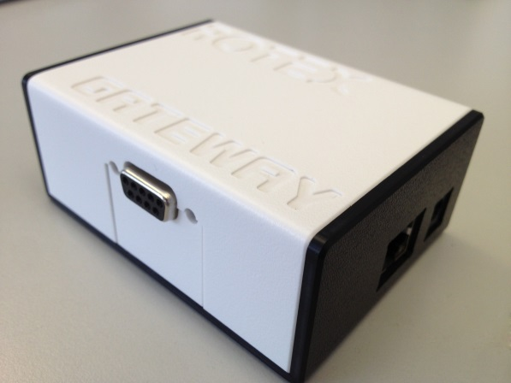
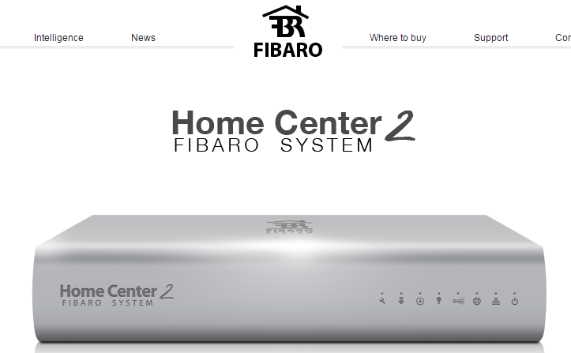
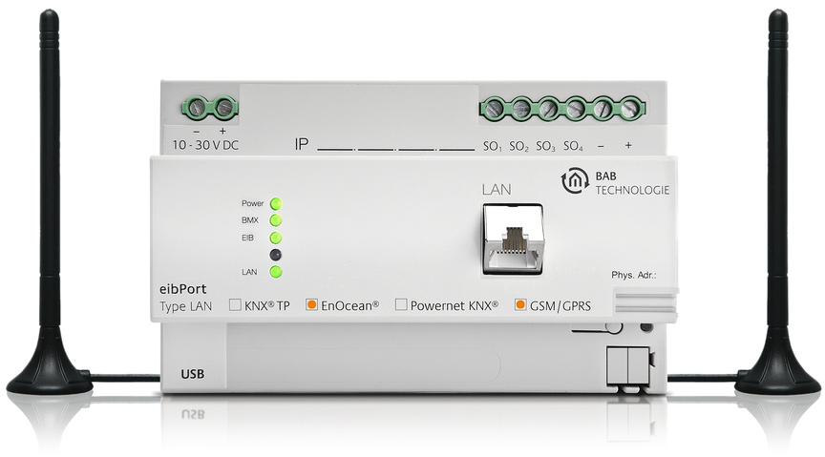
Gateway : commercial
Ethernet

Slide 23
WSN@home breakdown
Gateway :
Common platform same as node : uC + RF
802.3 (10/100 Mbps) / wiznet W5x00
RTC / display / reset button
Firmware :
baremetal, no bootloader
NRF24l01+ : mySensors stack (http://www.mysensors.org)
Reduced MQTT (http://mqtt.org/) client (IP stack / wiznet W5100)
+-99% mem utilisation

Slide 24
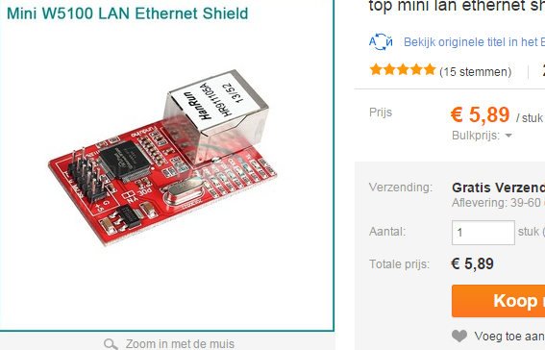
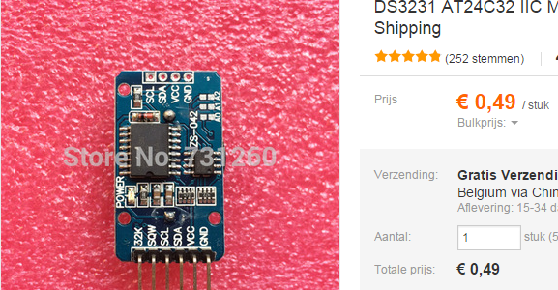
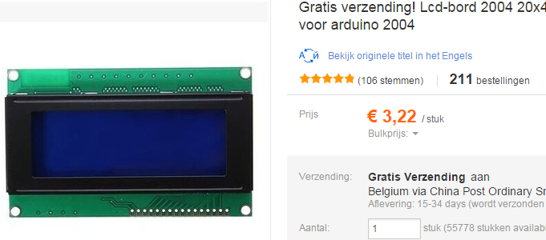
WSN@home breakdown
Gateway :
cost

Slide 25
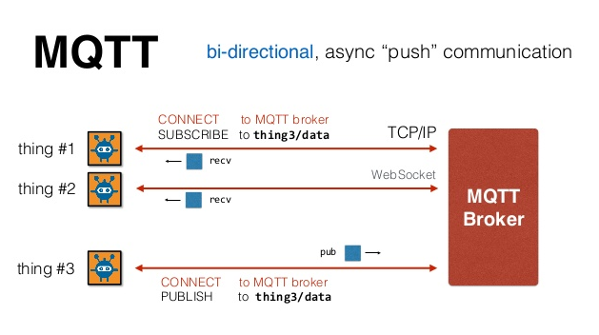

MQTT
MQ (message queueing) telemetry transport (http://mqtt.org/)
Lightweight protocol on top of TCP/IP (e.g. facebook messenger)

Slide 26
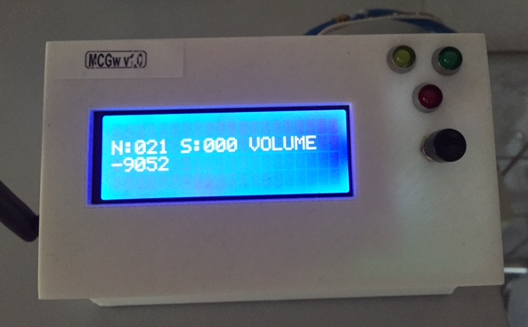
WSN@home breakdown
Gateway :
3D printed case, designed in OpenSCAD (http://www.openscad.org/)

Slide 27

WSN@home breakdown
Controller :
Openhab (http://www.openhab.org/)

Slide 28
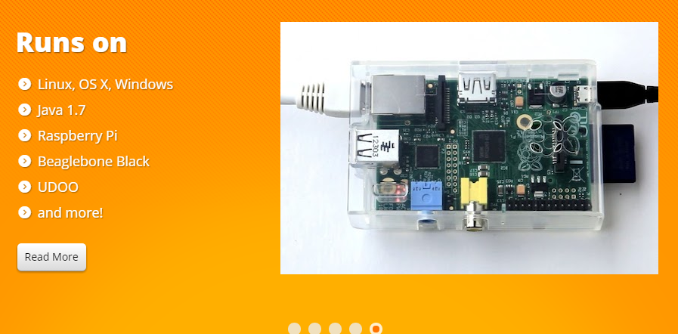
WSN@home breakdown
Controller :
…but the real power are the BINDINGS (https://github.com/openhab/openhab/wiki/Bindings)
…including MQTT

Slide 29
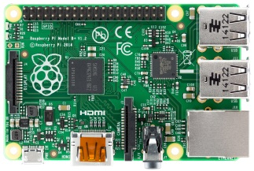


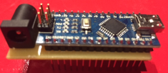
WSN@home breakdown
LAN
MQTT
Controller

Slide 30
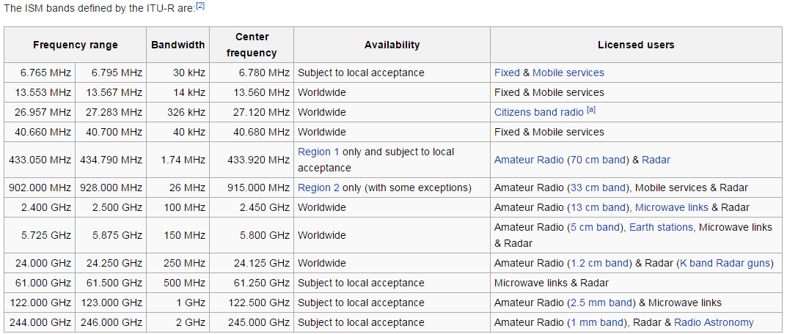
About RF
ISM (Industrial, Scientific and Medical) band : license free
Short range band (433/868/916MHz)

Slide 31
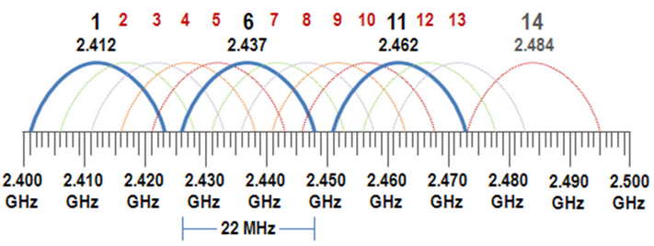
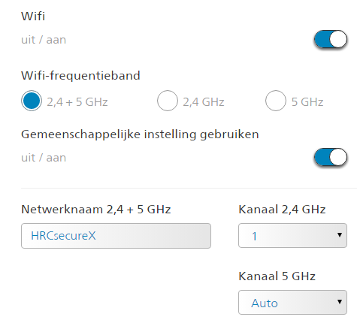
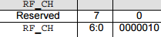
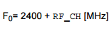
About RF : interference
Whatever you use, think about interference : (remote, alarm, microwave (=2.45GHz), Wifi, Bluetooth,…)
http://www.nordicsemi.com/eng/Products/2.4GHz-RF/nRF24L01
2.476Ghz

Slide 32
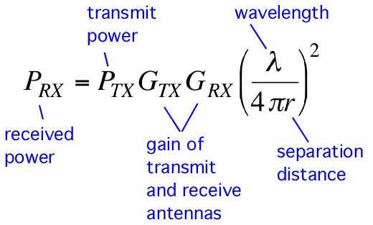
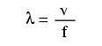
About RF : path losses
Friis transmission equation
Receive power increase by :
Higher TX power
Better antennas
Shorter distance
Lower frequency
* Power * ANTENNE
* Control distance
(MESHING)

Slide 33

Todo…
Nodes :
Design :
OTA
encryption,
Proto PCB -> fab
Proto :
mailbox, doorbell,
smart CV,PIR,
garage, light, …
Debug/test : Wifi sniffer
Gateway : multi-RF / ESP8266
Controller : rules, rules, rules…

Slide 34
Interested in …
Which sensor node do you want to build ?
WSN@work ?

